Slide 1





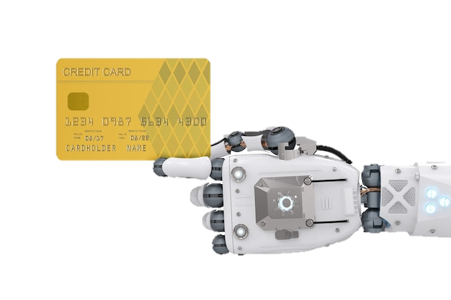
Customer Segmentation for Marketing Strategy
Ayah Abu Thib , Amjad Abderrahmane , Ashraf Abdulkhaliq
Supervisor: Hussain Salih

Slide 2

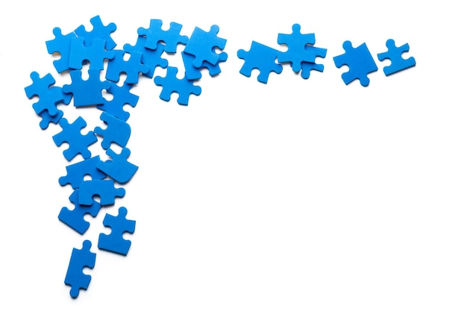


The Big Picture
The goal is to explore unsupervised techniques to make a model that can segment an unlabeled dataset.

Slide 3


Introduction
Overview:
This project was realized in the context of ShAI training Level 2
Dataset:
Credit Card Dataset for Clustering
Importance:
Customer segmentation allows for tailored marketing messages and strategies, increasing campaigns effectiveness.

Slide 4
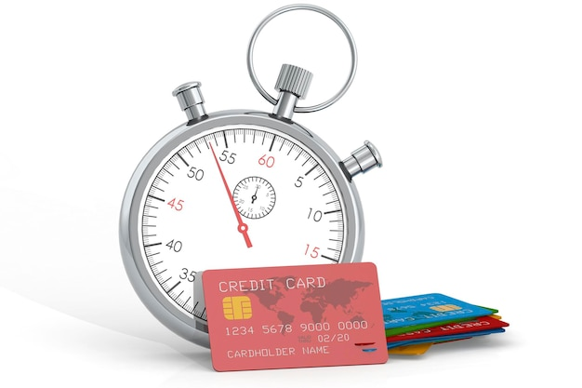
Time schedule
Social Meeting : Knowing each other and prepare for the next stages
EDA : Studying deeply the dataset. Analyze statistics and plots.
Preparing the data for the model
Exploring # algorithms
Finishing : Preparing the final files.

Slide 5

Exploratory Data Analysis (EDA)
Understanding Customer Behavior
Visualizations:
Histograms for data distribution (BALANCE, PURCHASES, etc.).
Boxplots to identify potential outliers and data spread.
Insights:
Spending patterns vary widely across users.
Some outliers might require further investigation.

Slide 6




Analyzing The Data ($\frac{1}{2}$)
Removing irrelevant feature (ID column).
Checking the existence of duplicate rows.
Handling missing values.
“CREDIT_LIMIT ” → One missing value.
“MINIMUM_PAYMENTS” → 313 missing values.
Imputation based on the mode.

Slide 7
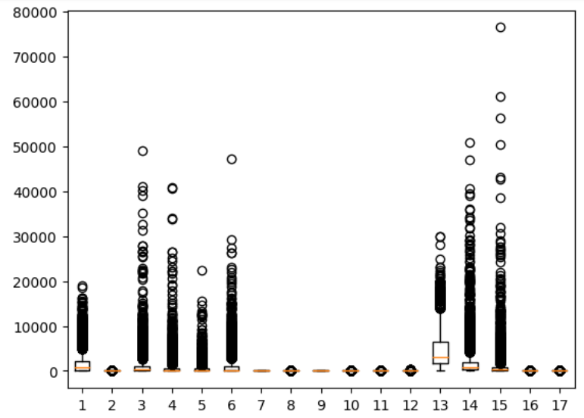

Analyzing The Data ($\frac{2}{2}$)
Checking for outliers (boxplot)
Exploring “Winsorizing” approach.
Our experiments revealed that removing outliers results in lower scores.

Slide 8
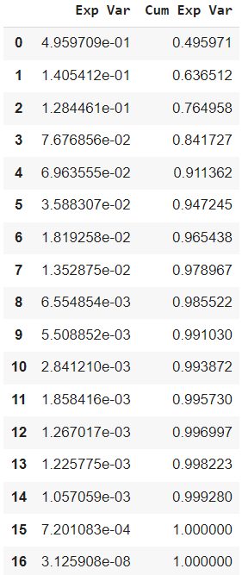


Dimensionality Reduction (PCA)
PCA reduces data complexity while preserving key information.
Using PCA, in our case reduced considerably the scores.

Slide 9

Feature Scaling
Normalizing the Data
Importance:
Ensures features contribute equally to clustering analysis.
Technique:
Min-MaxScaler scales features between 0 and 1.

Slide 10
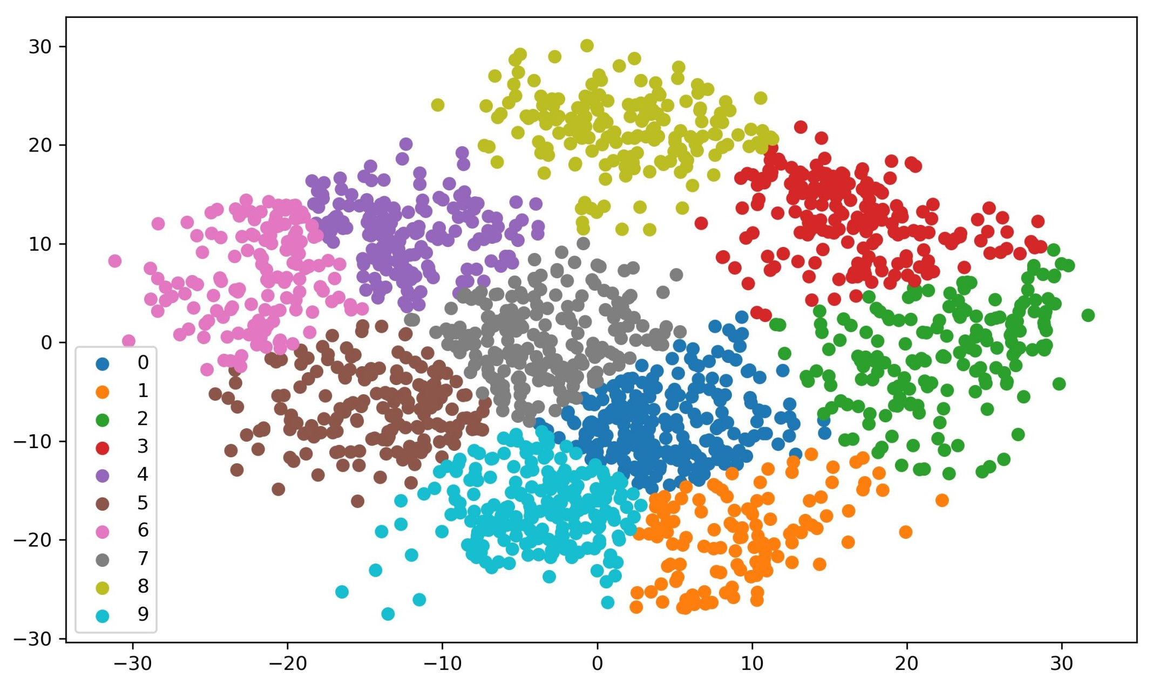

K-mean
First Experiment

Slide 11

Determining Optimal Clusters (Elbow Method)
WCSS (Within-Cluster Sum of Squares):
Measures cluster compactness.
Elbow Method Plot:
Shows WCSS for different cluster numbers.
Justification:
Choose the number of clusters where the WCSS curve bends sharply.

Slide 12

Evaluation Metrics (Silhouette Score)
Assessing Cluster Quality
Silhouette Score: Measures cluster cohesion and separation (1 = good, -1 = bad).
Silhouette Score Plot: Distribution of silhouette scores for each data point.
Interpretati (e.g., 0.5 might indicate good clustering).

Slide 13
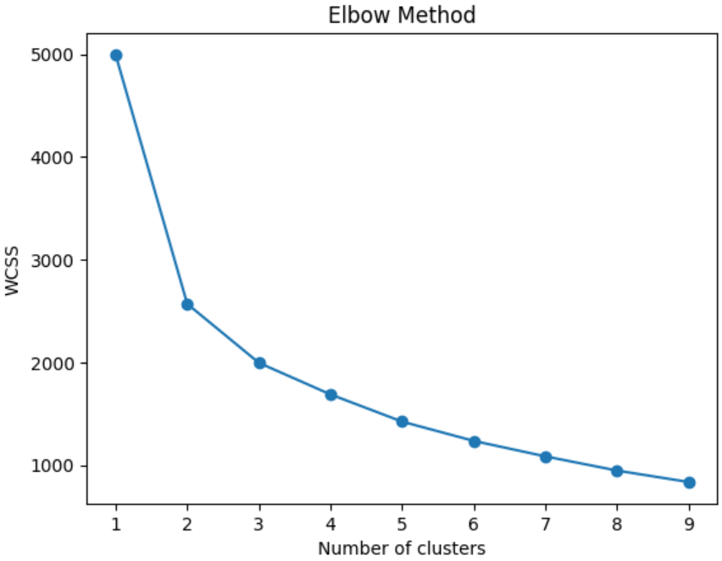
K-mean Results

Slide 14
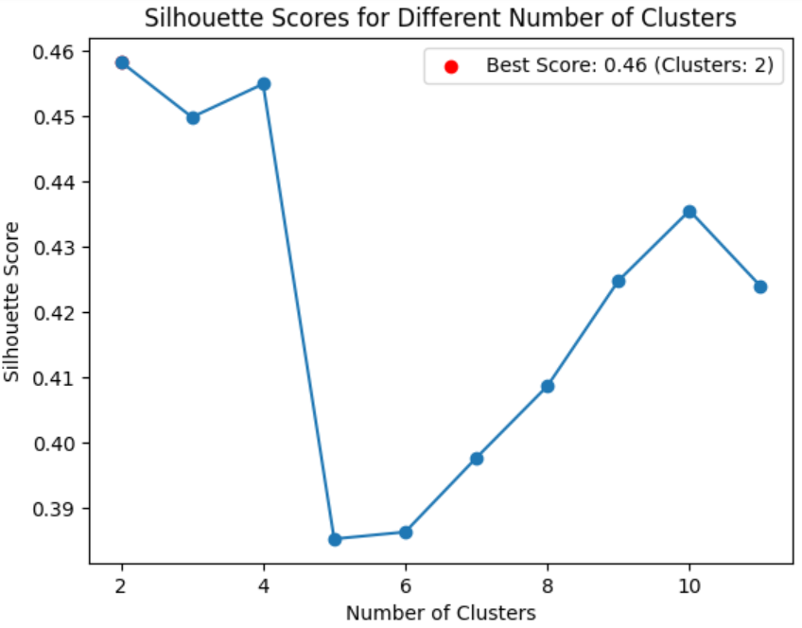
K-mean Results

Slide 15
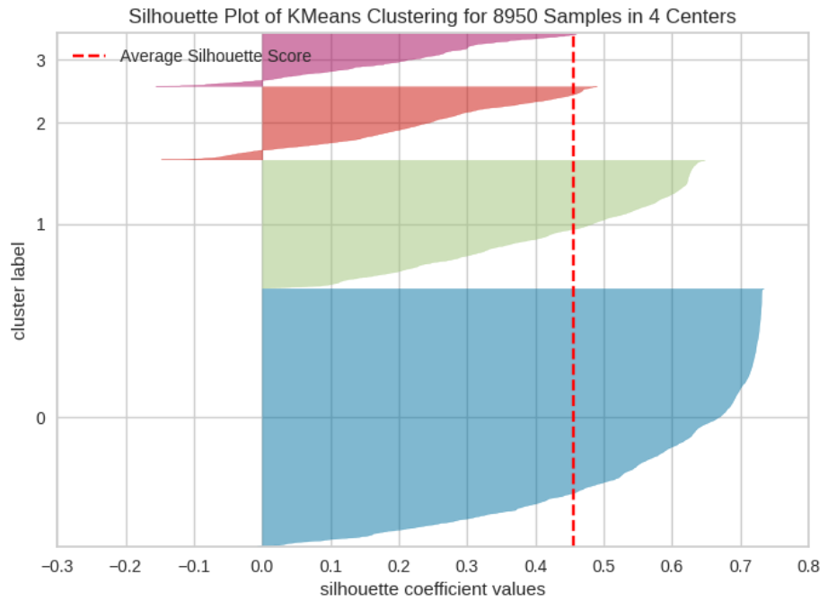
K-mean Results

Slide 16
K-mean Results
Cluster | Num of samples
1 | 4516
2 | 2244
3 | 1276
4 | 914

Slide 17

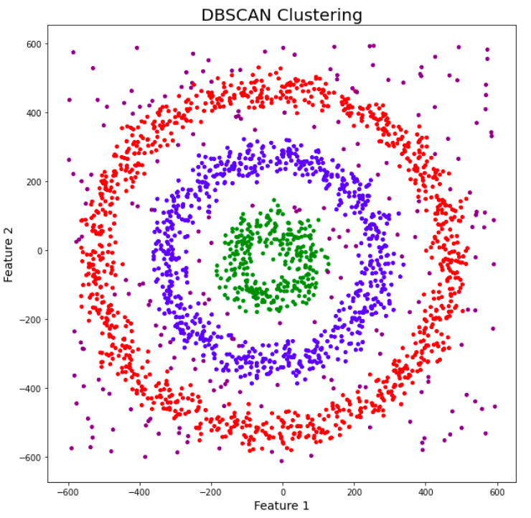
DBSCAN
Second Experiment

Slide 18


Data Preprocessing
Features Transformations:
Logarithm.
Square Root.
Cube Root.
Validate Normal Distribution:
Quantile-Quantile (Q-Q) plot is a graphical tool used to assess whether a given sample or dataset follows a specific theoretical distribution, such as a normal distribution.

Slide 19

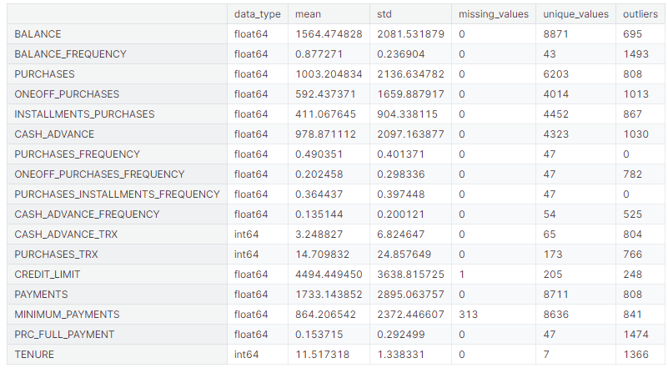
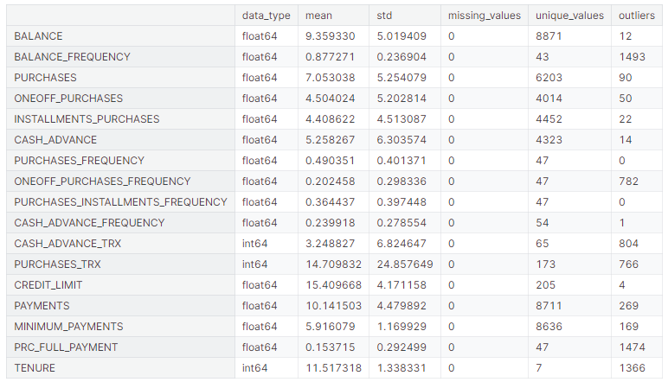
Data Transformation

Slide 20

Hyperparameter Tuning
We used Optuna to get the best hyperparameters “EPS+Min-samples” for our model DBSCAN .
Obtained results:
EPS=(0.62).
Min-samples=(22).

Slide 21

Result Analysis
We obtained a silhouette_score of (0.26).
The data were grouped in two clusters having respectively: 4612 elements and 4295 elements.

Slide 22

K-mean wins

Slide 23


